Slide 1
Parabola in Parallelogram

Slide 2
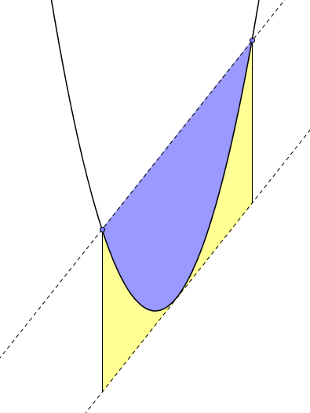




Parabola in Parallelogram
The coordinates of two points on the parallelogram, $A$ and $B$, are shown on the diagram. Also shown is the $x$-coordinate of the minimum point.
The upper dashed line extends the chord $AB$. The lower dashed line is parallel to chord $AB$ and is tangent to the parabola. The solid lines of the parallelogram are parallel to the $y$-axis.
Your task is to determine the ratio of the blue area to the yellow area.
$$B(23,67)$$
$$A(5,4)$$
$$minimum at x=7$$

Slide 3

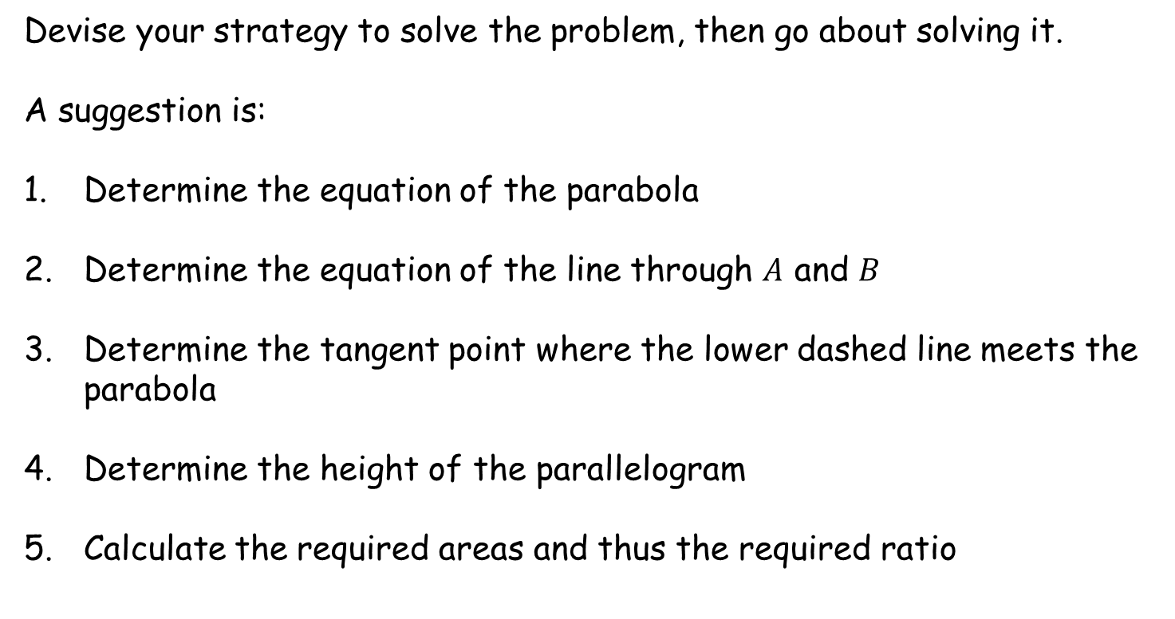
Parabola in Parallelogram
Devise your strategy to solve the problem, then go about solving it.
A suggestion is:
Determine the equation of the parabola
Determine the equation of the line through $A$ and $B$
Determine the tangent point where the lower dashed line meets the parabola
Determine the height of the parallelogram
Calculate the required areas and thus the required ratio

Slide 4
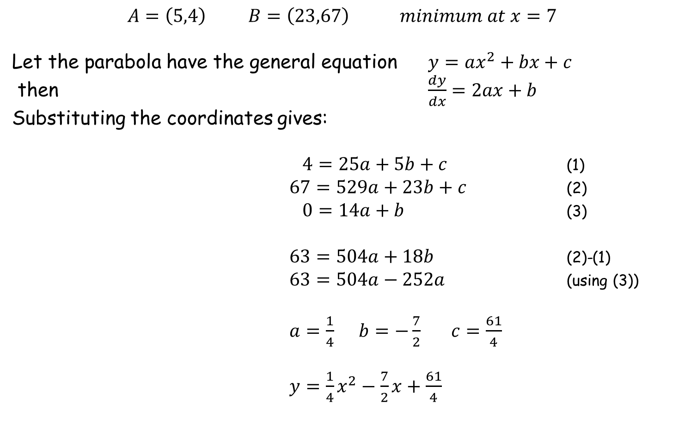
Parabola in Parallelogram
1. Determine the equation of the parabola
$$A=\left(5,4\right) B=\left(23,67\right) minimum at x=7$$
Let the parabola have the general equation $y=ax^{2}+bx+c$
then $\frac{dy}{dx}=2ax+b$
Substituting the coordinates gives:
$4=25a+5b+c$ (1)
$67=529a+23b+c$ (2)
$0=14a+b$ (3)
$63=504a+18b$ (2)-(1)
$63=504a−252a$ (using (3))
$a=\frac{1}{4}$ $b=−\frac{7}{2}$ $c=\frac{61}{4}$
$y=\frac{1}{4}x^{2}−\frac{7}{2}x+\frac{61}{4}$

Slide 5

Parabola in Parallelogram
2. Determine the equation of the line through $A$ and $B$
$$A=\left(5,4\right) B=\left(23,67\right) minimum at x=7$$
Using $\frac{y−y_{1}}{y_{2}−y_{1}}=\frac{x−x_{1}}{x_{2}−x_{1}}$
gives $\frac{y−4}{67−4}=\frac{x−5}{23−5}$
$\frac{y−4}{63}=\frac{x−5}{18}$
Leading to $y=\frac{7}{2}x−\frac{27}{2}$

Slide 6
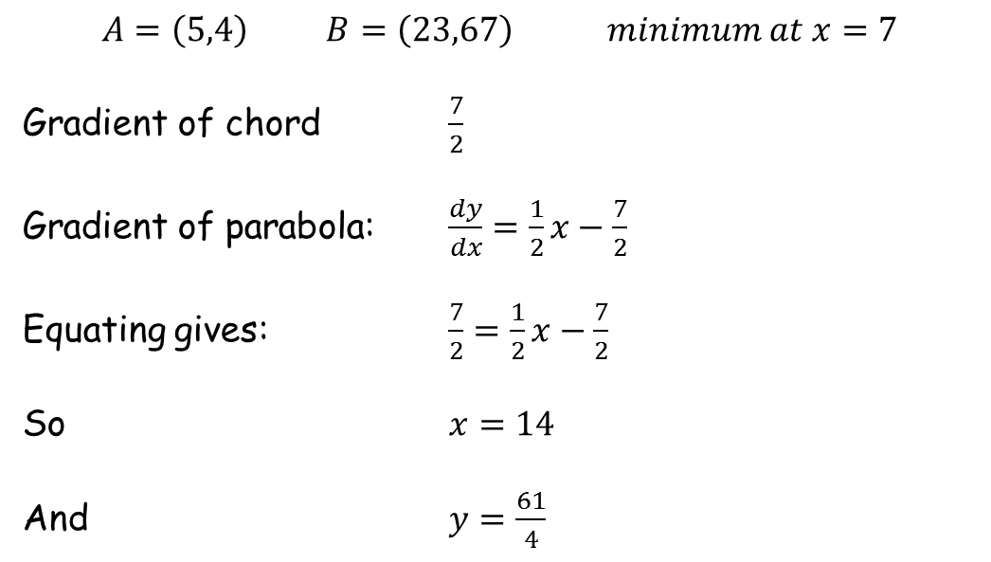
Parabola in Parallelogram
3. Determine the tangent point where the lower dashed line
meets the parabola
$$A=\left(5,4\right) B=\left(23,67\right) minimum at x=7$$
Gradient of chord $\frac{7}{2}$
Gradient of parabola: $\frac{dy}{dx}=\frac{1}{2}x−\frac{7}{2}$
Equating gives: $\frac{7}{2}=\frac{1}{2}x−\frac{7}{2}$
So $x=14$
And $y=\frac{61}{4}$

Slide 7
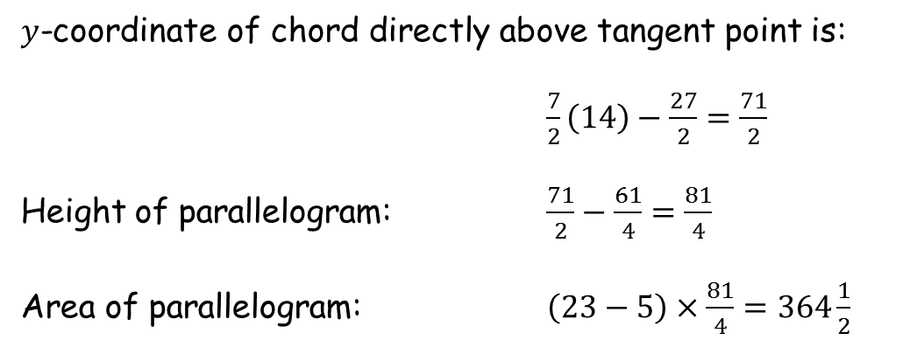
Parabola in Parallelogram
4. Determine the height of the parallelogram
$y$-coordinate of chord directly above tangent point is:
$\frac{7}{2}\left(14\right)−\frac{27}{2}=\frac{71}{2}$
Height of parallelogram: $\frac{71}{2}−\frac{61}{4}=\frac{81}{4}$
Area of parallelogram: $\left(23−5\right)×\frac{81}{4}=364\frac{1}{2}$

Slide 8
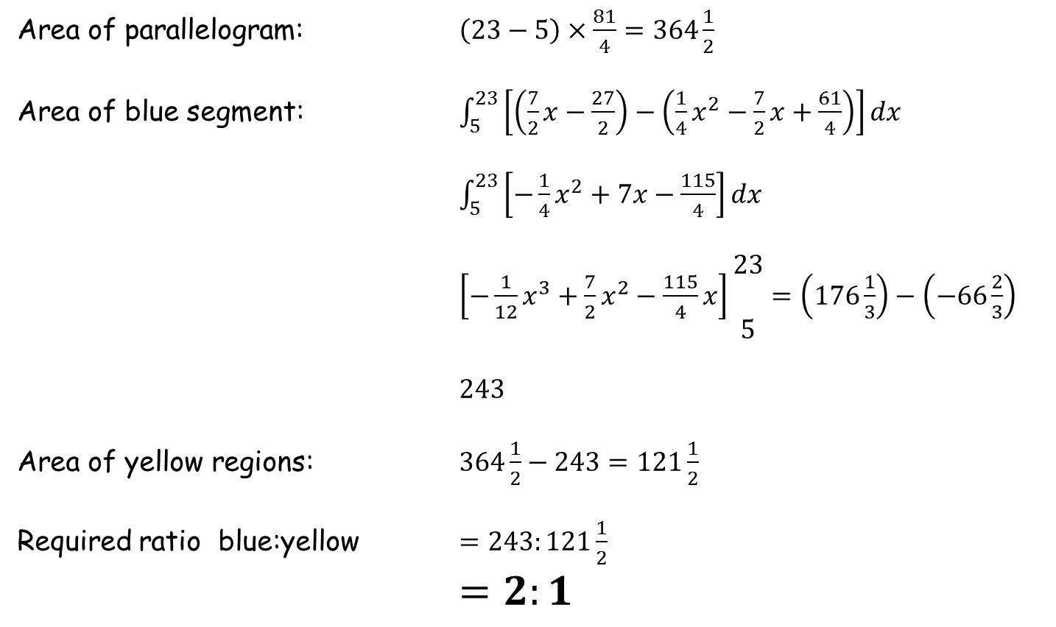
Parabola in Parallelogram
5. Determine the areas
Area of parallelogram: $\left(23−5\right)×\frac{81}{4}=364\frac{1}{2}$
Area of blue segment: $\int_{5}^{23}{\left[\left(\frac{7}{2}x−\frac{27}{2}\right)−\left(\frac{1}{4}x^{2}−\frac{7}{2}x+\frac{61}{4}\right)\right]dx}$
$\int_{5}^{23}{\left[−\frac{1}{4}x^{2}+7x−\frac{115}{4}\right]dx}$
$\left[−\frac{1}{12}x^{3}+\frac{7}{2}x^{2}−\frac{115}{4}x\right]\begin{matrix}23 \\ \\ 5\end{matrix}=\left(176\frac{1}{3}\right)−\left(−66\frac{2}{3}\right)$
$243$
Area of yellow regions: $364\frac{1}{2}−243=121\frac{1}{2}$
Required ratio blue:yellow $=243:121\frac{1}{2}$
$=2:1$

Slide 9
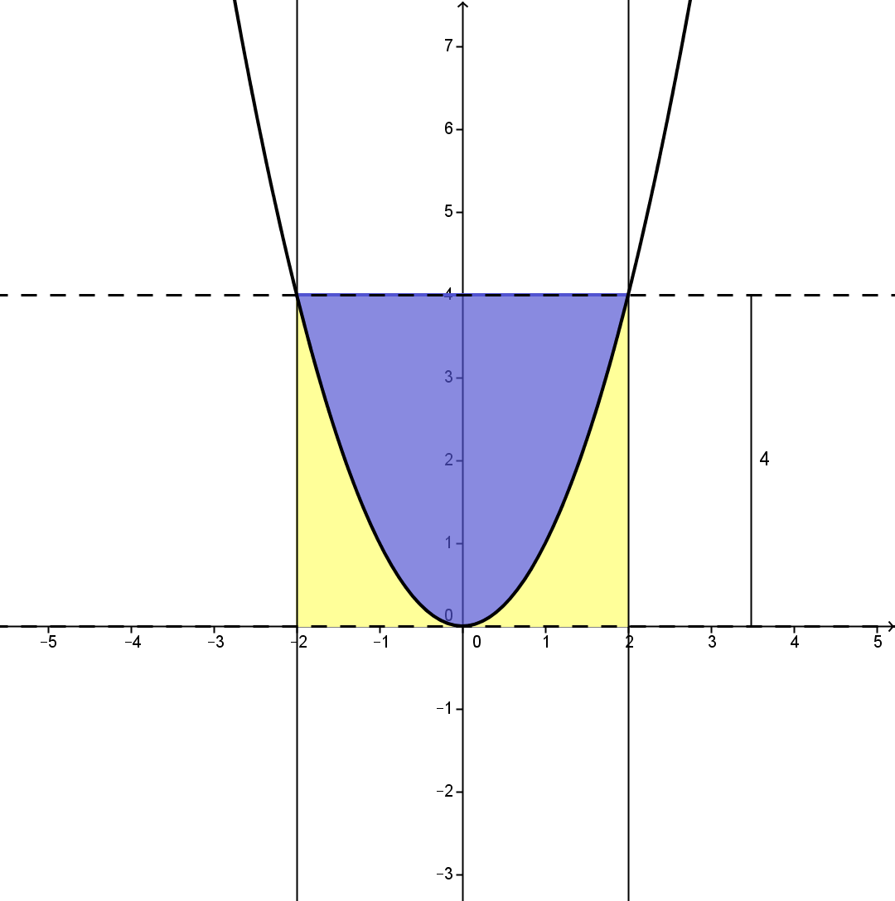
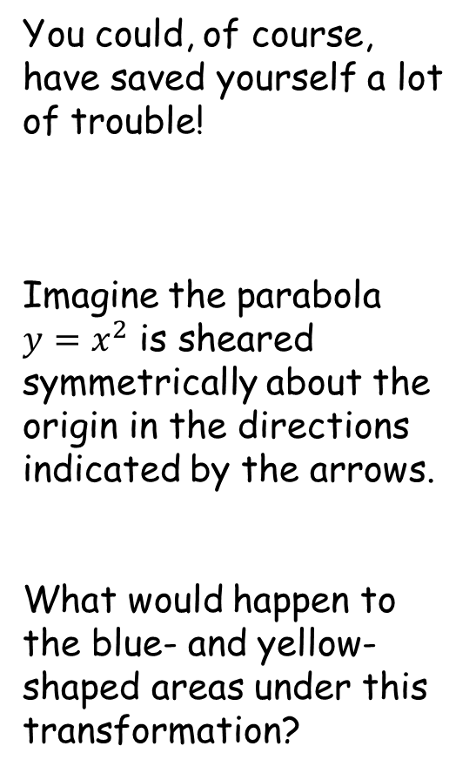
Parabola in Parallelogram
You could, of course, have saved yourself a lot of trouble!
Imagine the parabola $y=x^{2}$ is sheared symmetrically about the origin in the directions indicated by the arrows.
What would happen to the blue- and yellow-shaped areas under this transformation?

Slide 10
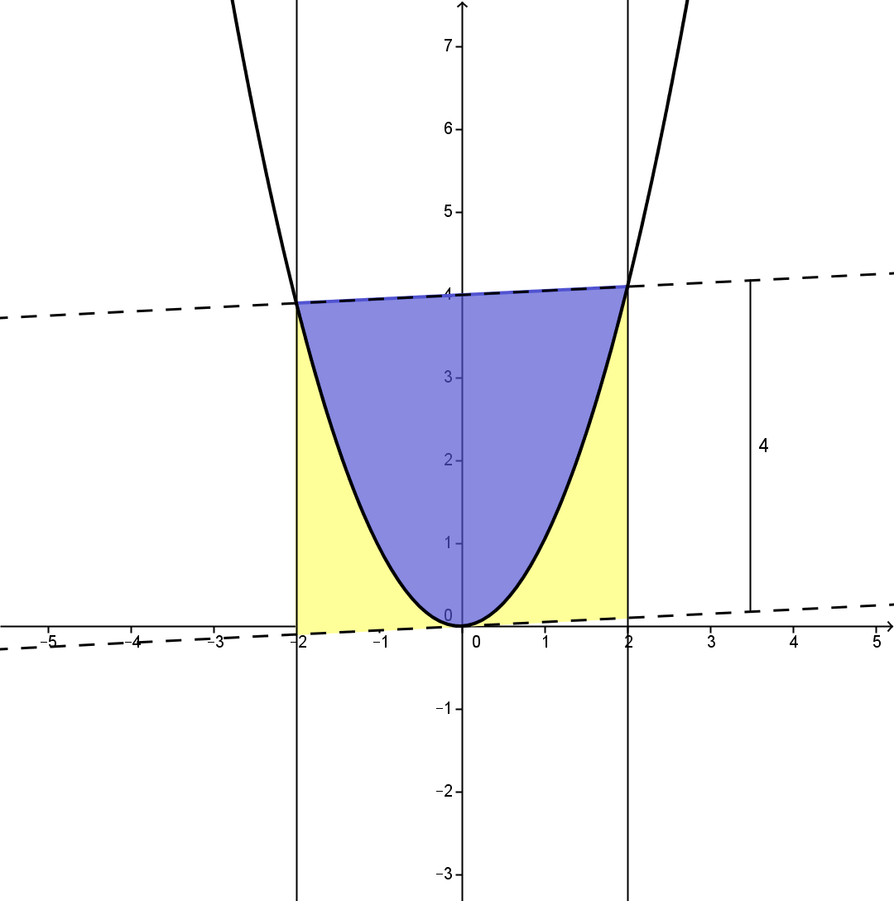
Parabola in Parallelogram

Slide 11
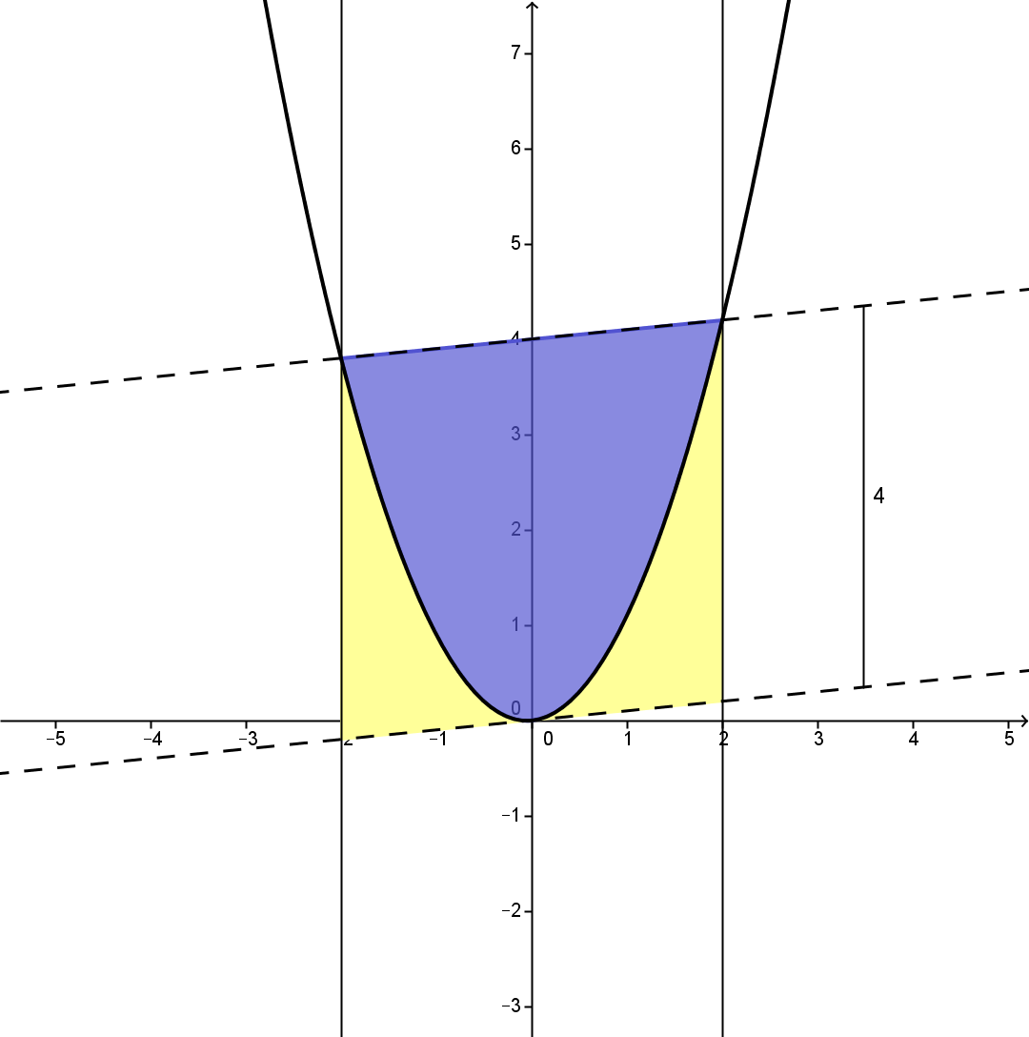
Parabola in Parallelogram

Slide 12
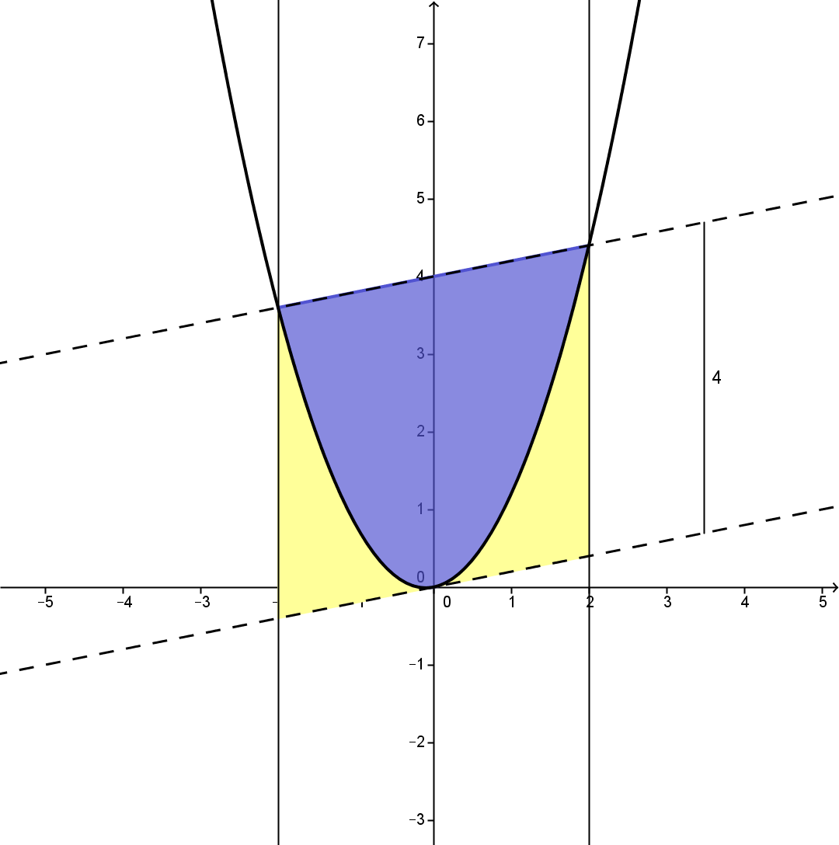
Parabola in Parallelogram

Slide 13
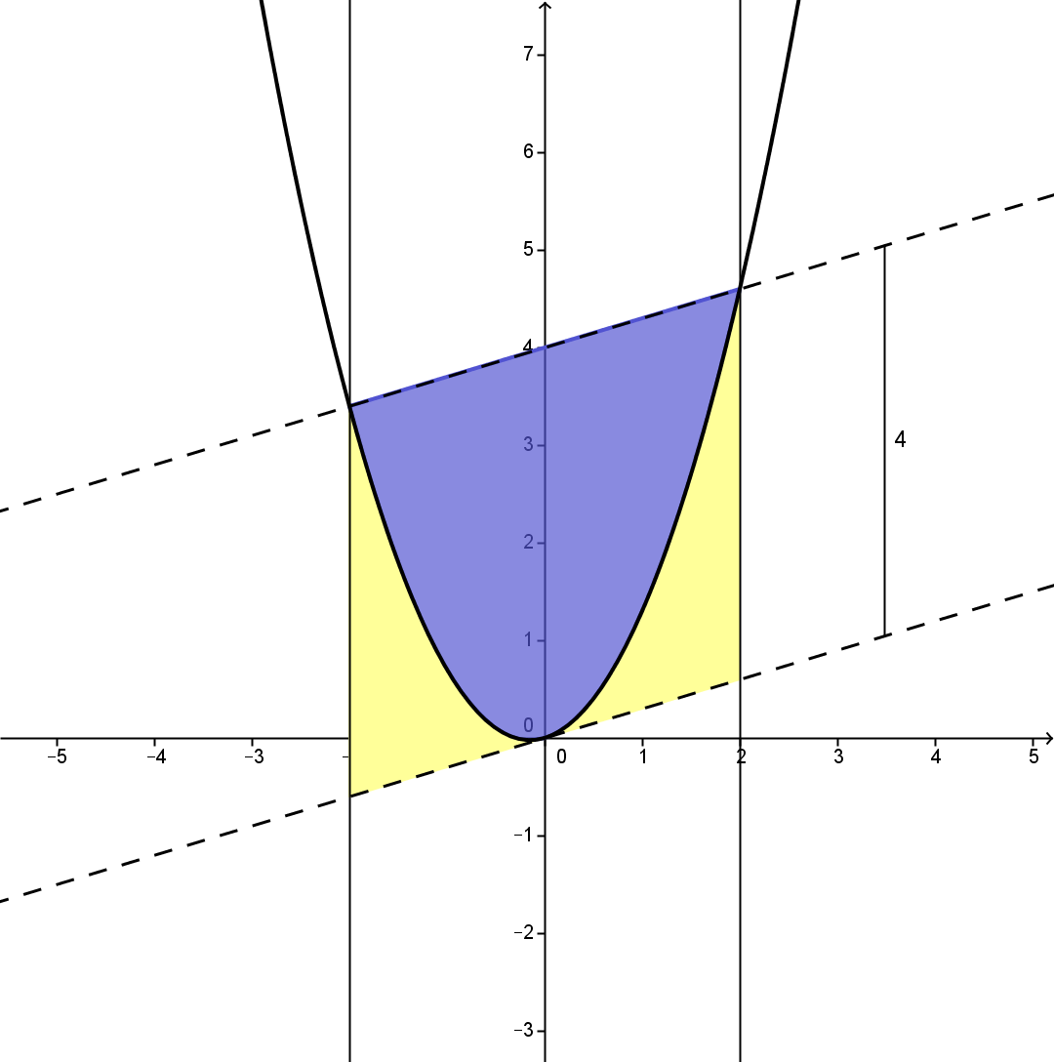
Parabola in Parallelogram

Slide 14
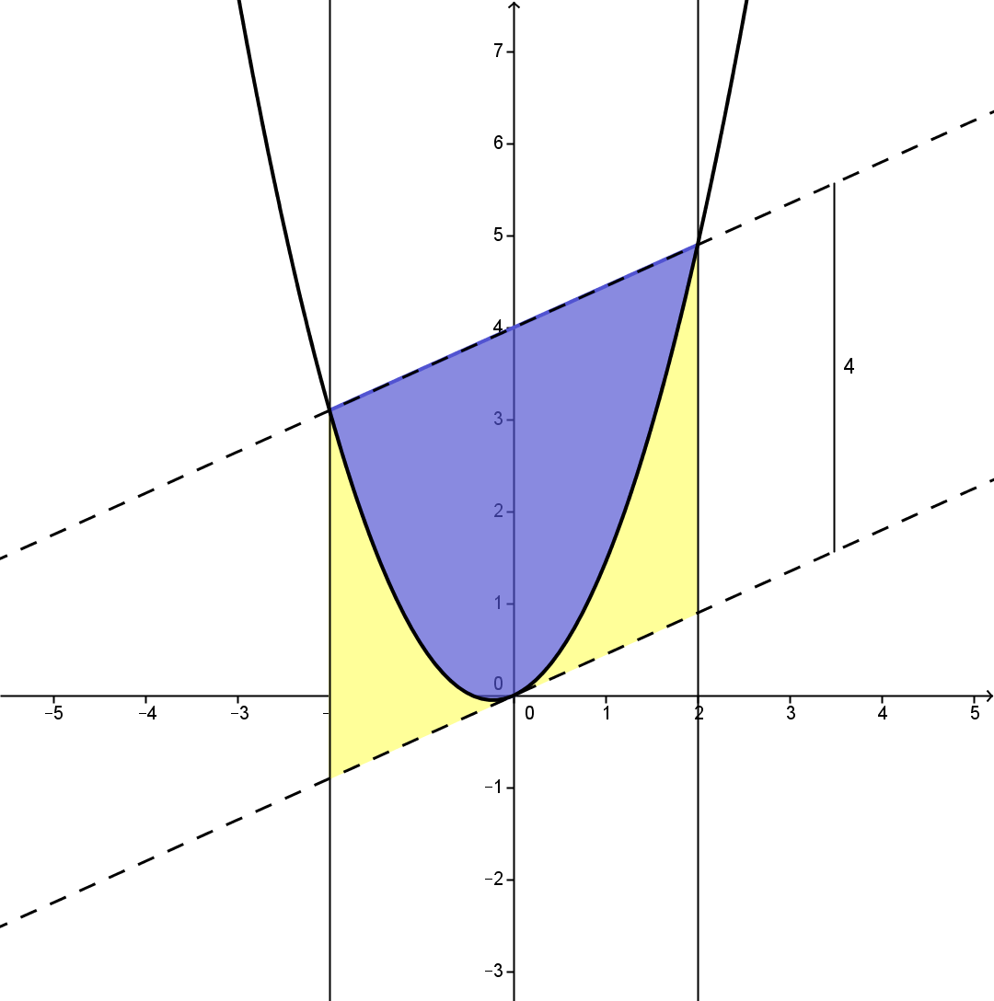
Parabola in Parallelogram

Slide 15
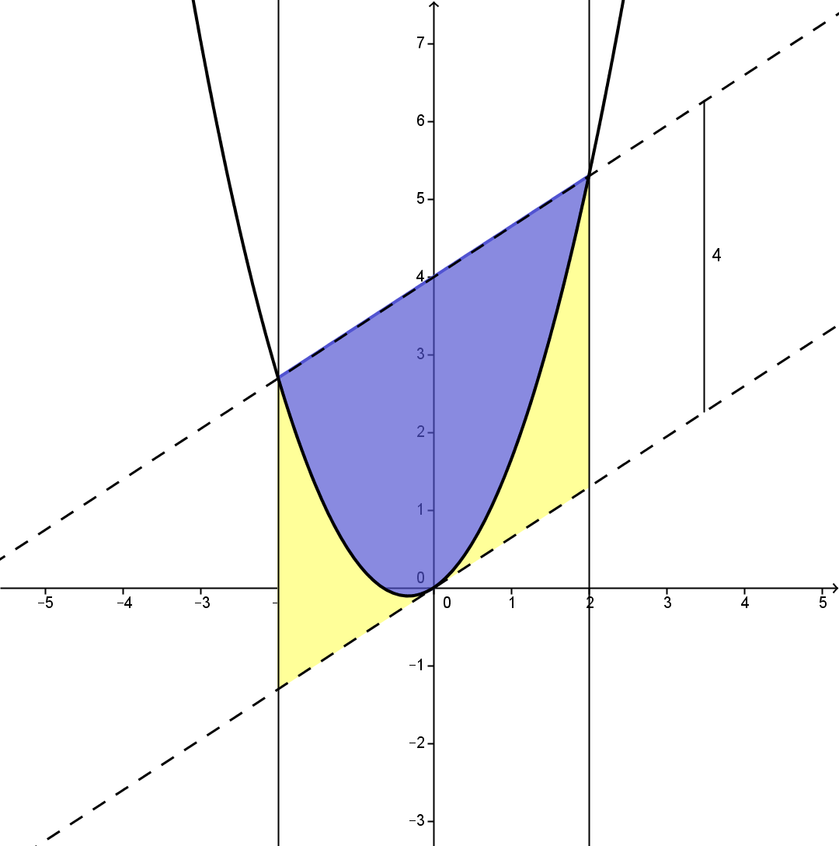
Parabola in Parallelogram

Slide 16
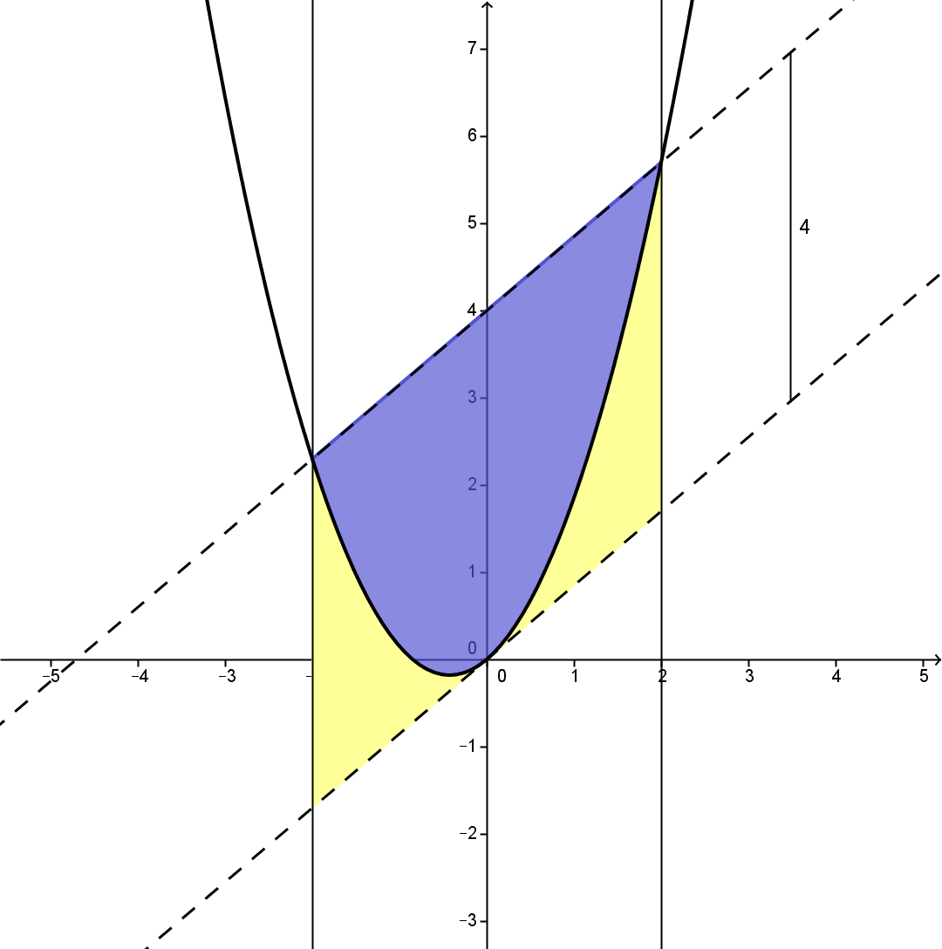
Parabola in Parallelogram

Slide 17
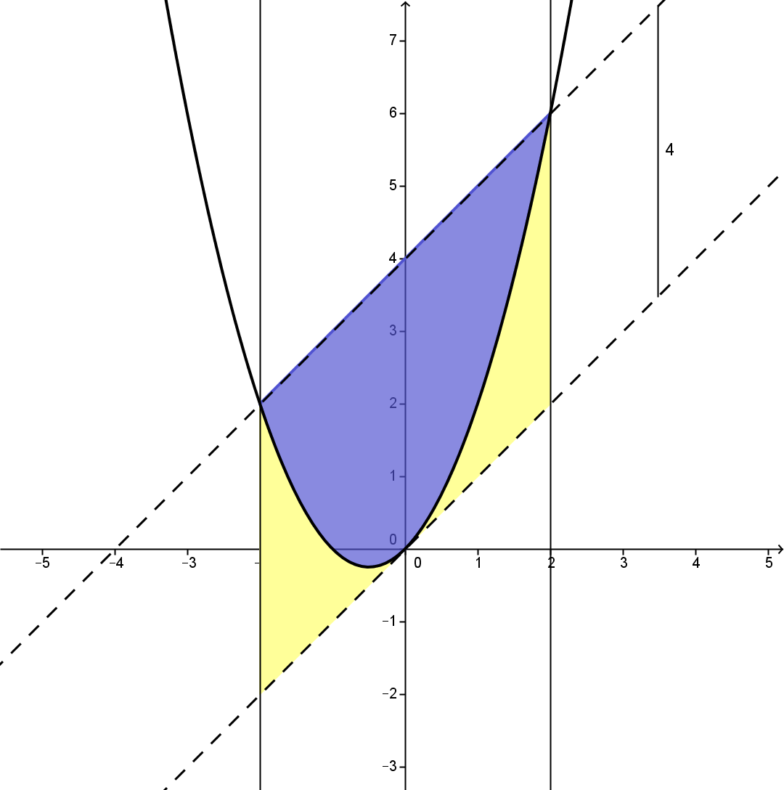
Parabola in Parallelogram

Slide 18
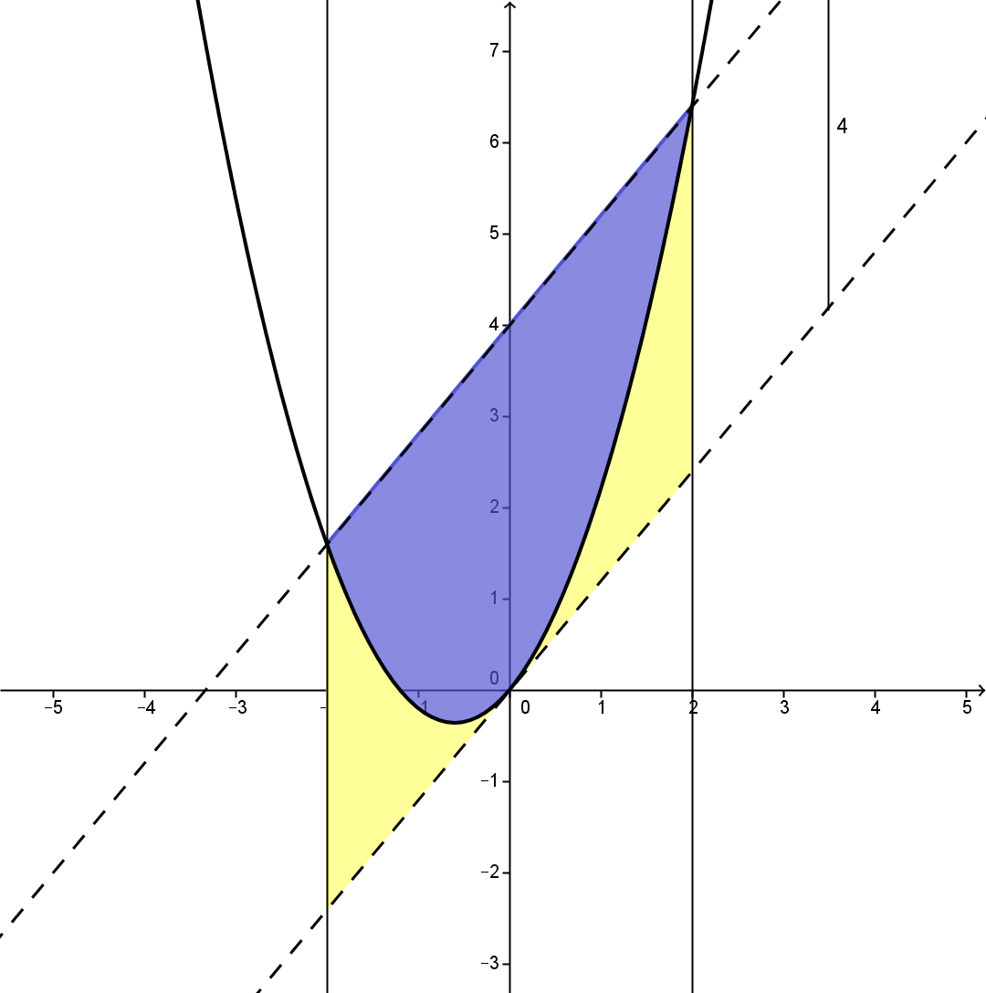
Parabola in Parallelogram

Slide 19
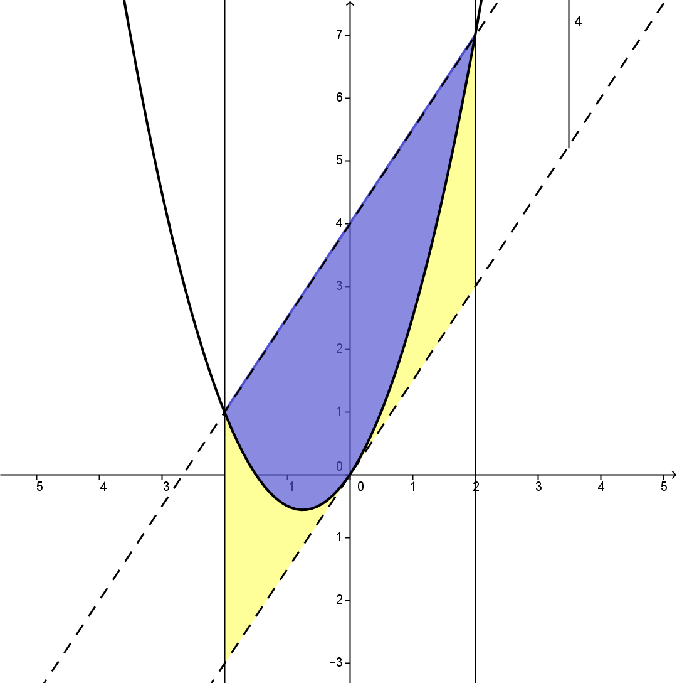
Parabola in Parallelogram
The vertical distance between the dashed parallel lines has not changed so the area of the parallelogram has not changed. So neither has the ratio of the area of the blue- and yellow-shaped areas.
Imagine the original rectangle chopped into vertical slices that slide under the shear – each slice has not changed length and so the area has not changed.

Slide 20
Parabola in Parallelogram
So where does this all leave us?
Knowing that the parallelogram you were given could have been transformed to a rectangle you could have made your analysis and integration much, much easier!

Slide 21
Parabola in Parallelogram
So where does this all leave us?
Knowing that the parallelogram you were given could have been transformed to a rectangle you could have made your analysis and integration much, much easier!

Slide 22
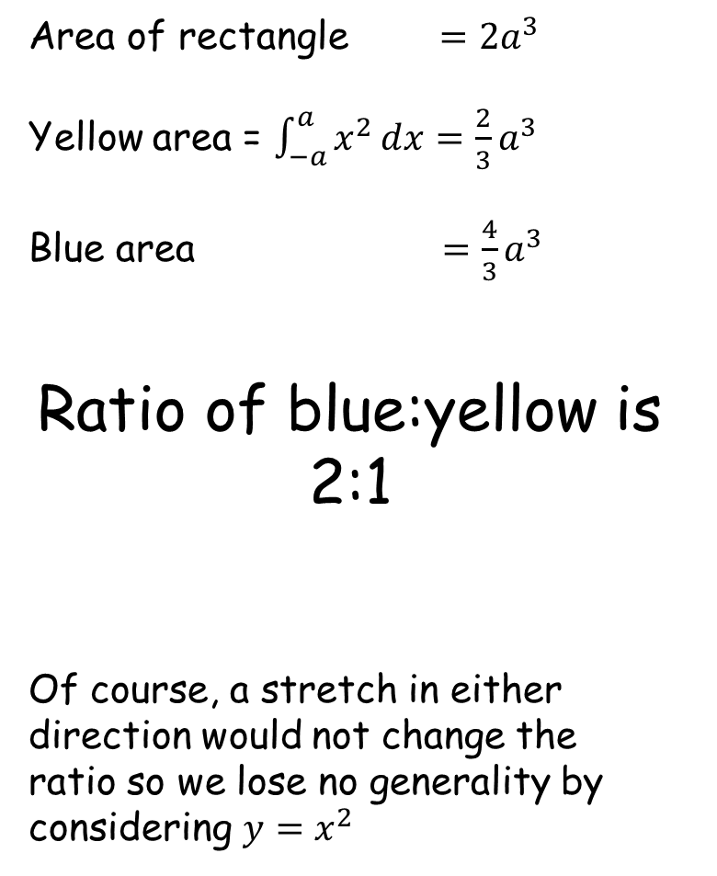




Parabola in Parallelogram
Area of rectangle $=2a^{3}$
Yellow area = $\int_{−a}^{a}{x^{2}ⅆx}=\frac{2}{3}a^{3}$
Blue area $=\frac{4}{3}a^{3}$
Ratio of blue:yellow is 2:1
Of course, a stretch in either direction would not change the ratio so we lose no generality by considering $y=x^{2}$
$${y=x}^{2}$$
$$a^{2}$$
$$−a$$
$$a$$

Slide 23
One final thought…
How could you do it without integration?

Slide 24
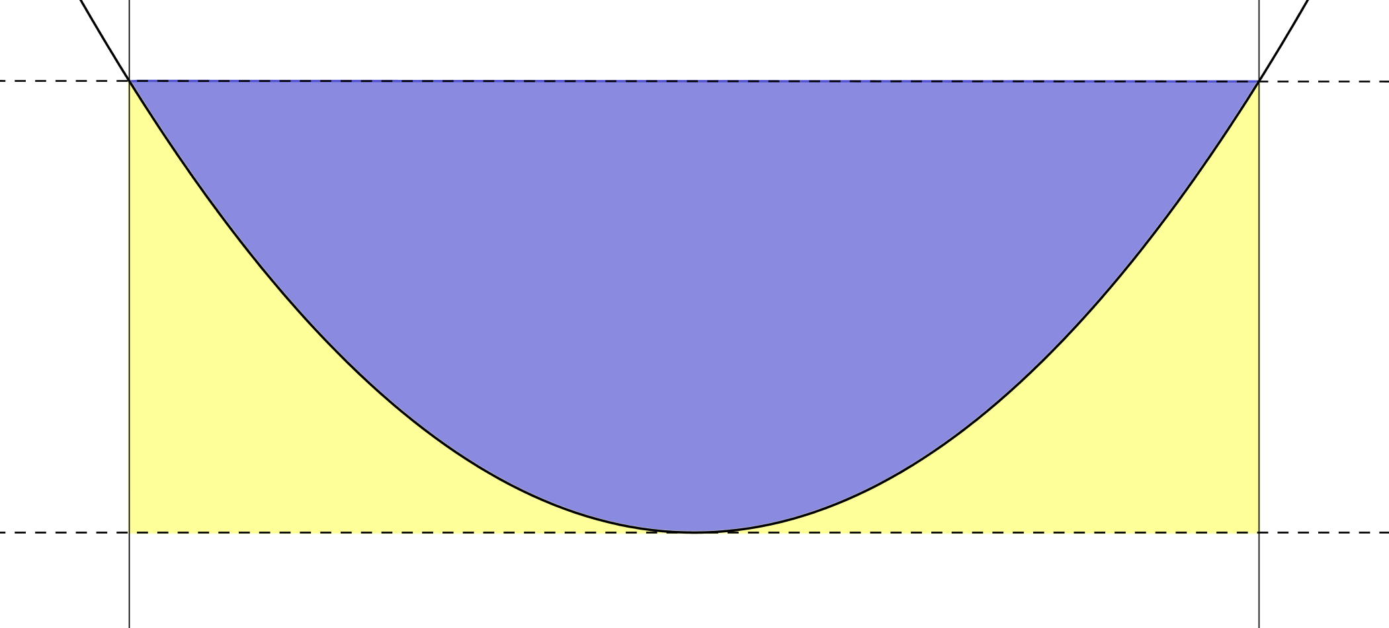
Let’s work out the area of the blue segment by a series of approximations

Slide 25
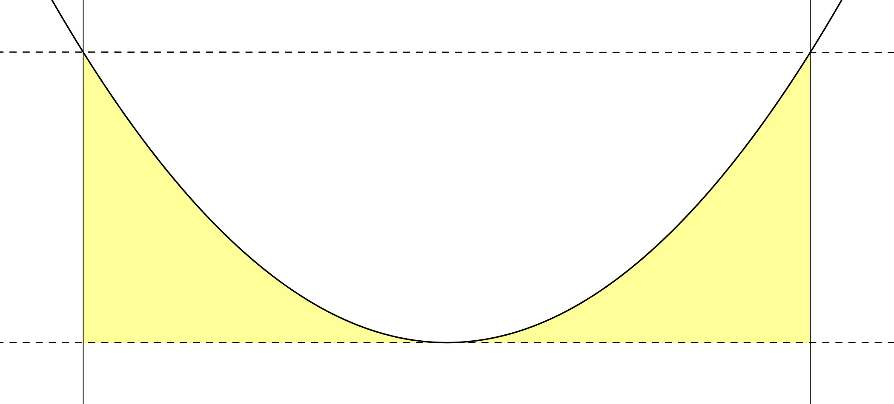




$${y=x}^{2}$$
$$a^{2}$$
$$−a$$
$$a$$

Slide 26
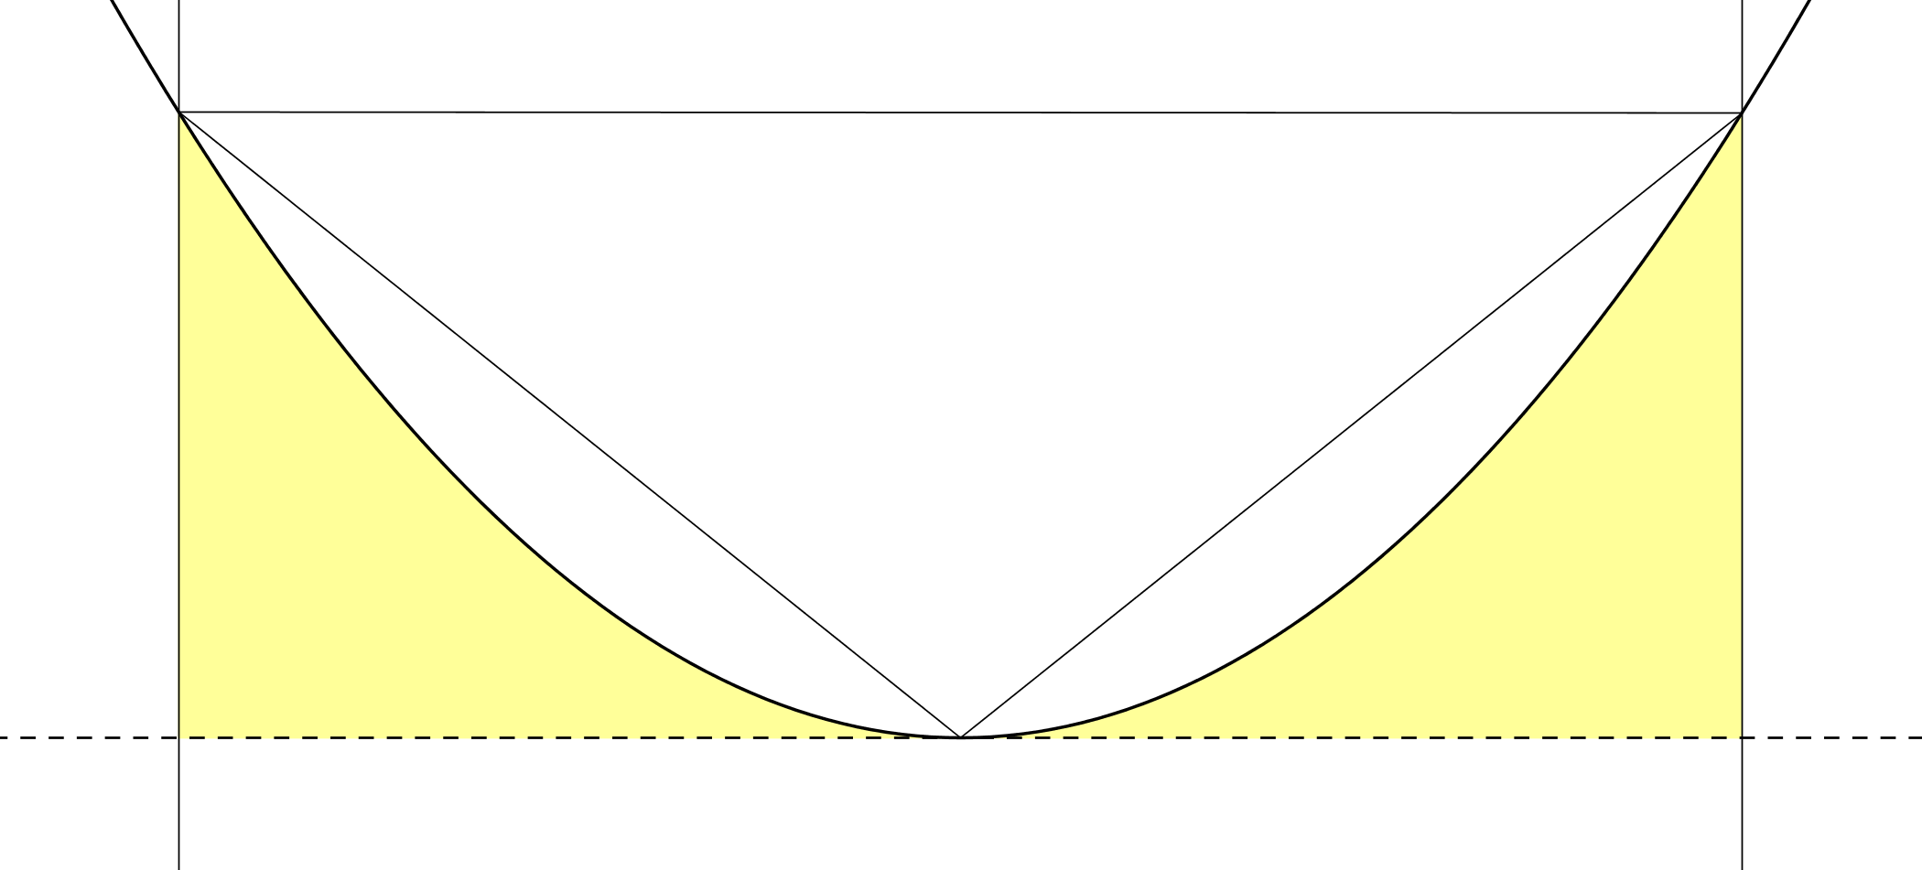
$${y=x}^{2}$$
$$a^{2}$$
$$−a$$
$$a$$

Slide 27
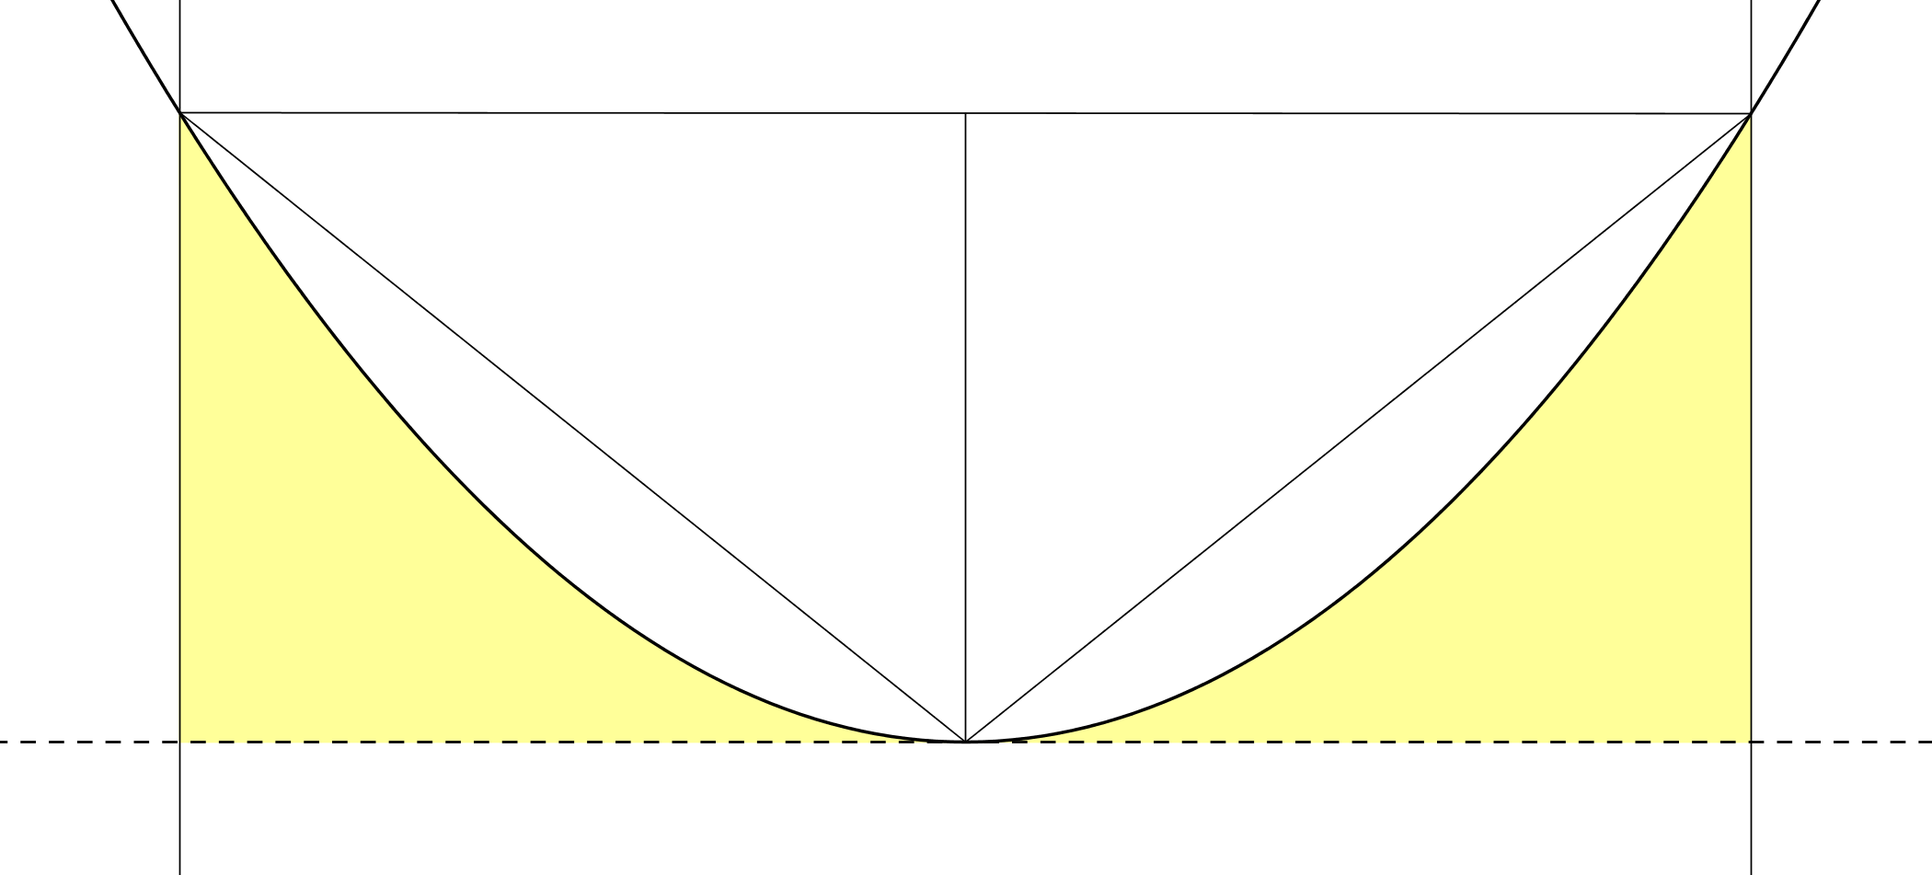
$${y=x}^{2}$$
$$a^{2}$$
$$−a$$
$$a$$

Slide 28
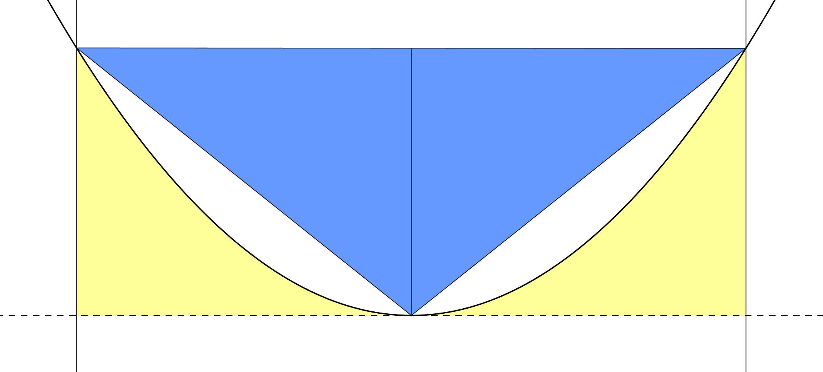
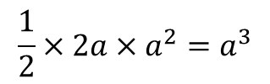
$${y=x}^{2}$$
$$\frac{1}{2}×2a×a^{2}=a^{3}$$
$$a^{2}$$
$$−a$$
$$a$$

Slide 29






$${y=x}^{2}$$
$$\frac{a^{2}}{2}$$
$$a^{3}$$
$$a^{2}$$
$$\frac{a^{2}}{4}$$
$$\frac{a^{2}}{4}$$
$$−a$$
$$\frac{a}{2}$$
$$a$$

Slide 30

$${y=x}^{2}$$
$$a^{3}$$
$$a^{2}$$
$$\frac{a^{2}}{4}$$
$$−a$$
$$a$$

Slide 31
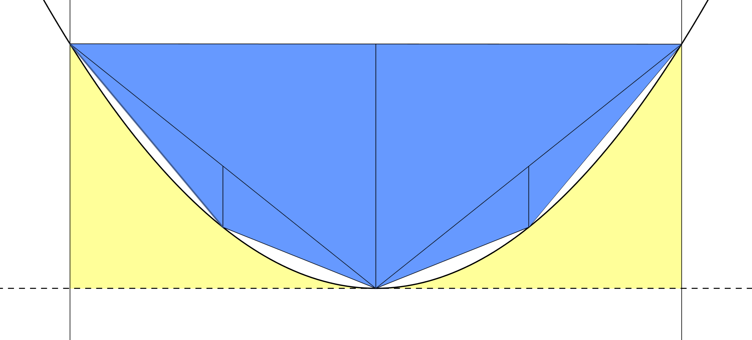
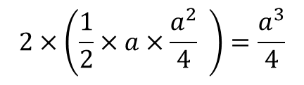
$${y=x}^{2}$$
$$a^{3}$$
$$a^{2}$$
$$−a$$
$$a$$
$$2×\left(\frac{1}{2}×a×\frac{a^{2}}{4} \right)=\frac{a^{3}}{4}$$

Slide 32
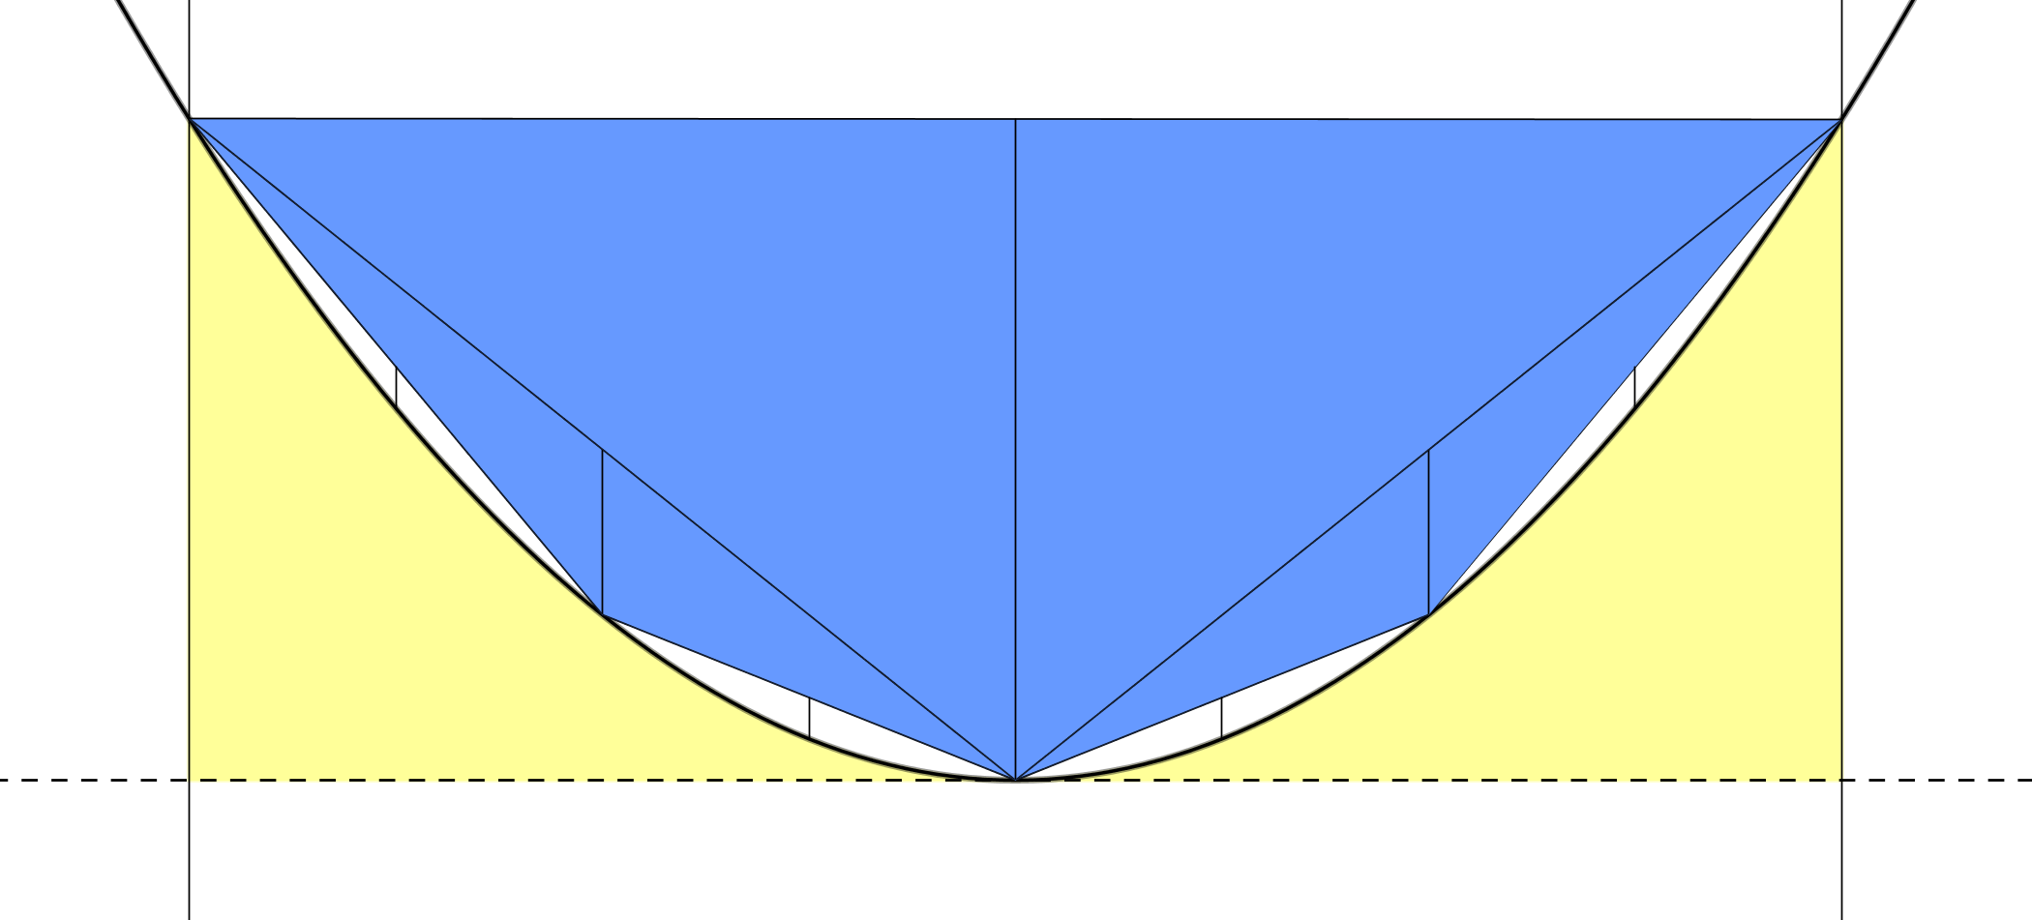





$${y=x}^{2}$$
$$a^{3}+\frac{a^{3}}{4}$$
$$\frac{3a^{2}}{4}+\frac{a^{2}}{8}$$
$$a^{2}$$
$$\frac{a^{2}}{16}$$
$$\frac{a^{2}}{16}$$
$$−a$$
$$\frac{a}{4}$$
$$a$$

Slide 33
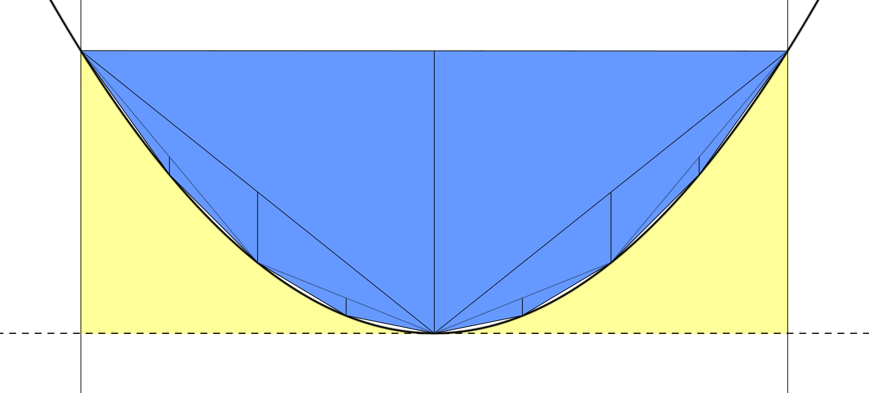
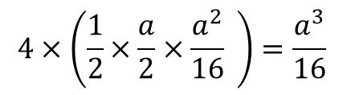
$${y=x}^{2}$$
$$a^{3}+\frac{a^{3}}{4}$$
$$a^{2}$$
$$−a$$
$$a$$
$$4×\left(\frac{1}{2}×\frac{a}{2}×\frac{a^{2}}{16} \right)=\frac{a^{3}}{16}$$

Slide 34
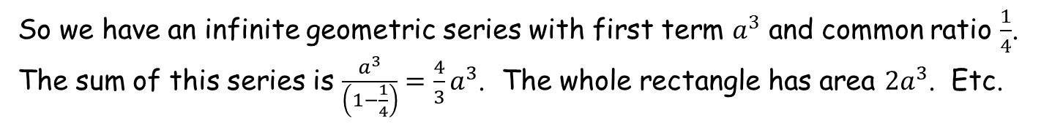
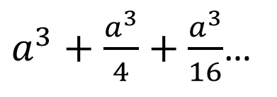
$${y=x}^{2}$$
$a^{3}+\frac{a^{3}}{4}+\frac{a^{3}}{16}$…
$$a^{2}$$
$$−a$$
$$a$$
So we have an infinite geometric series with first term $a^{3}$ and common ratio $\frac{1}{4}$. The sum of this series is $\frac{a^{3}}{\left(1−\frac{1}{4}\right)}=\frac{4}{3}a^{3}$. The whole rectangle has area $2a^{3}$. Etc.

Slide 36
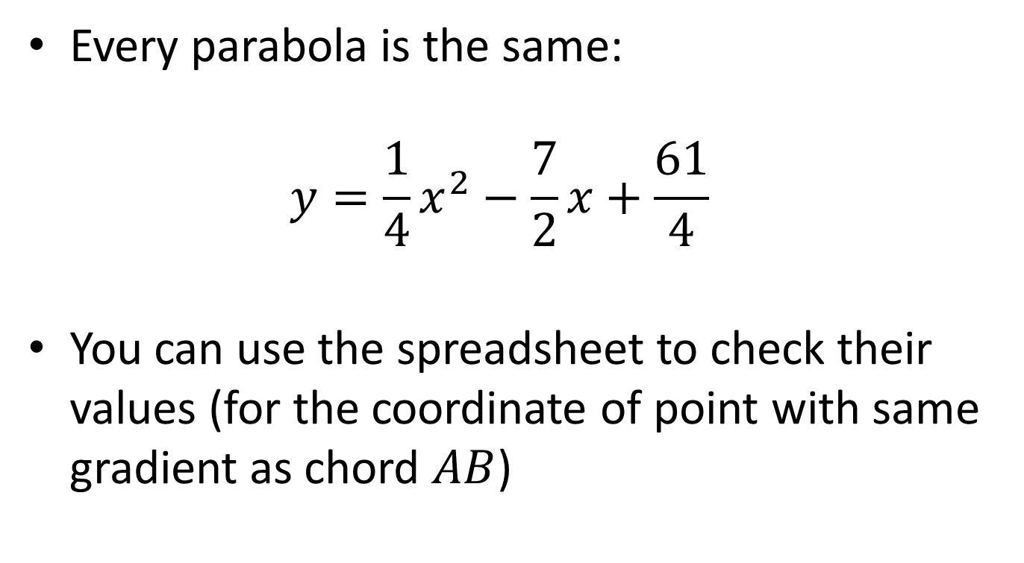
Note to Teacher
Every parabola is the same:
$y=\frac{1}{4}x^{2}−\frac{7}{2}x+\frac{61}{4}$
You can use the spreadsheet to check their values (for the coordinate of point with same gradient as chord $AB$)

Slide 37
RESOURCES

Slide 38


Parabola in Parallelogram
The coordinates of two points on the parallelogram, $A$ and $B$, are shown on the diagram. Also shown is the $x$-coordinate of the minimum point.
The upper dashed line extends the chord $AB$. The lower dashed line is parallel to chord $AB$ and is tangent to the parabola. The solid lines of the parallelogram are parallel to the $y$-axis.
Your task is to determine the ratio of the blue area to the yellow area.
$$B(15,19)$$
$$A(1,12)$$
A
$$minimum at x=7$$
SIC_30

Slide 39

Parabola in Parallelogram
The coordinates of two points on the parallelogram, $A$ and $B$, are shown on the diagram. Also shown is the $x$-coordinate of the minimum point.
The upper dashed line extends the chord $AB$. The lower dashed line is parallel to chord $AB$ and is tangent to the parabola. The solid lines of the parallelogram are parallel to the $y$-axis.
Your task is to determine the ratio of the blue area to the yellow area.
$$B(17,28)$$
$$A(1,12)$$
B
$$minimum at x=7$$
SIC_30

Slide 40

Parabola in Parallelogram
The coordinates of two points on the parallelogram, $A$ and $B$, are shown on the diagram. Also shown is the $x$-coordinate of the minimum point.
The upper dashed line extends the chord $AB$. The lower dashed line is parallel to chord $AB$ and is tangent to the parabola. The solid lines of the parallelogram are parallel to the $y$-axis.
Your task is to determine the ratio of the blue area to the yellow area.
$$B(19,39)$$
$$A(1,12)$$
C
$$minimum at x=7$$
SIC_30

Slide 41

Parabola in Parallelogram
The coordinates of two points on the parallelogram, $A$ and $B$, are shown on the diagram. Also shown is the $x$-coordinate of the minimum point.
The upper dashed line extends the chord $AB$. The lower dashed line is parallel to chord $AB$ and is tangent to the parabola. The solid lines of the parallelogram are parallel to the $y$-axis.
Your task is to determine the ratio of the blue area to the yellow area.
$$B(21,52)$$
$$A(1,12)$$
D
$$minimum at x=7$$
SIC_30

Slide 42


Parabola in Parallelogram
The coordinates of two points on the parallelogram, $A$ and $B$, are shown on the diagram. Also shown is the $x$-coordinate of the minimum point.
The upper dashed line extends the chord $AB$. The lower dashed line is parallel to chord $AB$ and is tangent to the parabola. The solid lines of the parallelogram are parallel to the $y$-axis.
Your task is to determine the ratio of the blue area to the yellow area.
$$B(13,12)$$
$$A(3,7)$$
E
$$minimum at x=7$$
SIC_30

Slide 43
Parabola in Parallelogram
The coordinates of two points on the parallelogram, $A$ and $B$, are shown on the diagram. Also shown is the $x$-coordinate of the minimum point.
The upper dashed line extends the chord $AB$. The lower dashed line is parallel to chord $AB$ and is tangent to the parabola. The solid lines of the parallelogram are parallel to the $y$-axis.
Your task is to determine the ratio of the blue area to the yellow area.
$$B(15,19)$$
$$A(3,7)$$
F
$$minimum at x=7$$
SIC_30

Slide 44
Parabola in Parallelogram
The coordinates of two points on the parallelogram, $A$ and $B$, are shown on the diagram. Also shown is the $x$-coordinate of the minimum point.
The upper dashed line extends the chord $AB$. The lower dashed line is parallel to chord $AB$ and is tangent to the parabola. The solid lines of the parallelogram are parallel to the $y$-axis.
Your task is to determine the ratio of the blue area to the yellow area.
$$B(17,28)$$
$$A(3,7)$$
G
$$minimum at x=7$$
SIC_30

Slide 45
Parabola in Parallelogram
The coordinates of two points on the parallelogram, $A$ and $B$, are shown on the diagram. Also shown is the $x$-coordinate of the minimum point.
The upper dashed line extends the chord $AB$. The lower dashed line is parallel to chord $AB$ and is tangent to the parabola. The solid lines of the parallelogram are parallel to the $y$-axis.
Your task is to determine the ratio of the blue area to the yellow area.
$$B(21,52)$$
$$A(3,7)$$
H
$$minimum at x=7$$
SIC_30

Slide 46


Parabola in Parallelogram
The coordinates of two points on the parallelogram, $A$ and $B$, are shown on the diagram. Also shown is the $x$-coordinate of the minimum point.
The upper dashed line extends the chord $AB$. The lower dashed line is parallel to chord $AB$ and is tangent to the parabola. The solid lines of the parallelogram are parallel to the $y$-axis.
Your task is to determine the ratio of the blue area to the yellow area.
$$B(11,7)$$
$$A(5,4)$$
I
$$minimum at x=7$$
SIC_30

Slide 47
Parabola in Parallelogram
The coordinates of two points on the parallelogram, $A$ and $B$, are shown on the diagram. Also shown is the $x$-coordinate of the minimum point.
The upper dashed line extends the chord $AB$. The lower dashed line is parallel to chord $AB$ and is tangent to the parabola. The solid lines of the parallelogram are parallel to the $y$-axis.
Your task is to determine the ratio of the blue area to the yellow area.
$$B(13,12)$$
$$A(5,4)$$
J
$$minimum at x=7$$
SIC_30

Slide 48
Parabola in Parallelogram
The coordinates of two points on the parallelogram, $A$ and $B$, are shown on the diagram. Also shown is the $x$-coordinate of the minimum point.
The upper dashed line extends the chord $AB$. The lower dashed line is parallel to chord $AB$ and is tangent to the parabola. The solid lines of the parallelogram are parallel to the $y$-axis.
Your task is to determine the ratio of the blue area to the yellow area.
$$B(17,28)$$
$$A(5,4)$$
K
$$minimum at x=7$$
SIC_30

Slide 49
Parabola in Parallelogram
The coordinates of two points on the parallelogram, $A$ and $B$, are shown on the diagram. Also shown is the $x$-coordinate of the minimum point.
The upper dashed line extends the chord $AB$. The lower dashed line is parallel to chord $AB$ and is tangent to the parabola. The solid lines of the parallelogram are parallel to the $y$-axis.
Your task is to determine the ratio of the blue area to the yellow area.
$$B(21,52)$$
$$A(5,4)$$
L
$$minimum at x=7$$
SIC_30

Slide 50

Parabola in Parallelogram
The coordinates of two points on the parallelogram, $A$ and $B$, are shown on the diagram. Also shown is the $x$-coordinate of the minimum point.
The upper dashed line extends the chord $AB$. The lower dashed line is parallel to chord $AB$ and is tangent to the parabola. The solid lines of the parallelogram are parallel to the $y$-axis.
Your task is to determine the ratio of the blue area to the yellow area.
$$B(17,28)$$
$$A(−1,19)$$
M
$$minimum at x=7$$
SIC_30

Slide 51
Parabola in Parallelogram
The coordinates of two points on the parallelogram, $A$ and $B$, are shown on the diagram. Also shown is the $x$-coordinate of the minimum point.
The upper dashed line extends the chord $AB$. The lower dashed line is parallel to chord $AB$ and is tangent to the parabola. The solid lines of the parallelogram are parallel to the $y$-axis.
Your task is to determine the ratio of the blue area to the yellow area.
$$B(19,39)$$
$$A(−1,19)$$
N
$$minimum at x=7$$
SIC_30

Slide 52
Parabola in Parallelogram
The coordinates of two points on the parallelogram, $A$ and $B$, are shown on the diagram. Also shown is the $x$-coordinate of the minimum point.
The upper dashed line extends the chord $AB$. The lower dashed line is parallel to chord $AB$ and is tangent to the parabola. The solid lines of the parallelogram are parallel to the $y$-axis.
Your task is to determine the ratio of the blue area to the yellow area.
$$B(21,52)$$
$$A(−1,19)$$
O
$$minimum at x=7$$
SIC_30

Slide 53
Parabola in Parallelogram
The coordinates of two points on the parallelogram, $A$ and $B$, are shown on the diagram. Also shown is the $x$-coordinate of the minimum point.
The upper dashed line extends the chord $AB$. The lower dashed line is parallel to chord $AB$ and is tangent to the parabola. The solid lines of the parallelogram are parallel to the $y$-axis.
Your task is to determine the ratio of the blue area to the yellow area.
$$B(23,67)$$
$$A(−1,19)$$
P
$$minimum at x=7$$
SIC_30

Slide 54
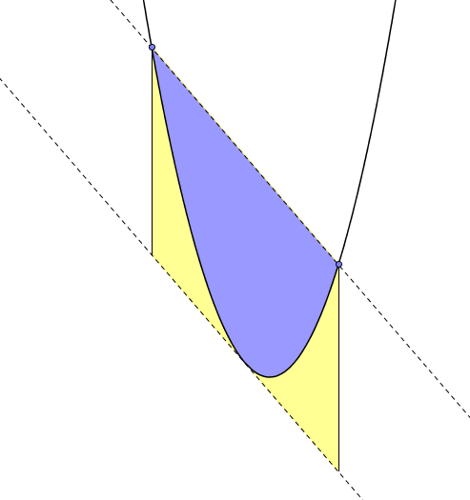



Parabola in Parallelogram
$$A(−1,19)$$
The coordinates of two points on the parallelogram, $A$ and $B$, are shown on the diagram. Also shown is the $x$-coordinate of the minimum point.
The upper dashed line extends the chord $AB$. The lower dashed line is parallel to chord $AB$ and is tangent to the parabola. The solid lines of the parallelogram are parallel to the $y$-axis.
Your task is to determine the ratio of the blue area to the yellow area.
$$B(9,4)$$
Q
$$minimum at x=7$$
SIC_30

Slide 55

Parabola in Parallelogram
$$A(−1,19)$$
The coordinates of two points on the parallelogram, $A$ and $B$, are shown on the diagram. Also shown is the $x$-coordinate of the minimum point.
The upper dashed line extends the chord $AB$. The lower dashed line is parallel to chord $AB$ and is tangent to the parabola. The solid lines of the parallelogram are parallel to the $y$-axis.
Your task is to determine the ratio of the blue area to the yellow area.
$$B(11,7)$$
R
$$minimum at x=7$$
SIC_30

Slide 56

Parabola in Parallelogram
$$A(−1,19)$$
The coordinates of two points on the parallelogram, $A$ and $B$, are shown on the diagram. Also shown is the $x$-coordinate of the minimum point.
The upper dashed line extends the chord $AB$. The lower dashed line is parallel to chord $AB$ and is tangent to the parabola. The solid lines of the parallelogram are parallel to the $y$-axis.
Your task is to determine the ratio of the blue area to the yellow area.
$$B(13,12)$$
S
$$minimum at x=7$$
SIC_30

Slide 57


Parabola in Parallelogram
$$A(−5,39)$$
The coordinates of two points on the parallelogram, $A$ and $B$, are shown on the diagram. Also shown is the $x$-coordinate of the minimum point.
The upper dashed line extends the chord $AB$. The lower dashed line is parallel to chord $AB$ and is tangent to the parabola. The solid lines of the parallelogram are parallel to the $y$-axis.
Your task is to determine the ratio of the blue area to the yellow area.
$$B(15,19)$$
T
$$minimum at x=7$$
SIC_30

Slide 58
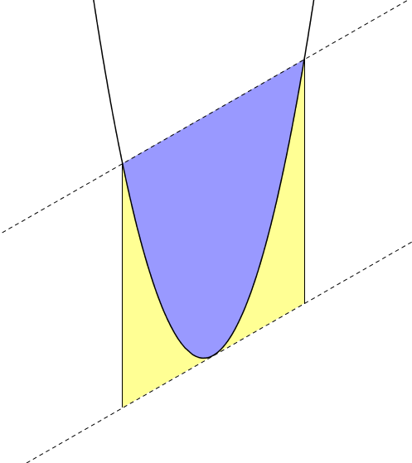

Slide 59
